Slide 1

Simplifying Fares
Ride More / Save More
Proposed Fare Policy Update
March 2024
Notes:
Welcome to the public meeting for the proposed Fare Policy Change. The goal of this meeting is to inform the public on JTA’s plan to simplify its fares structure on fixed route buses and show you how when you Ride More, You Save More using the MyJTA mobile app.

Slide 2
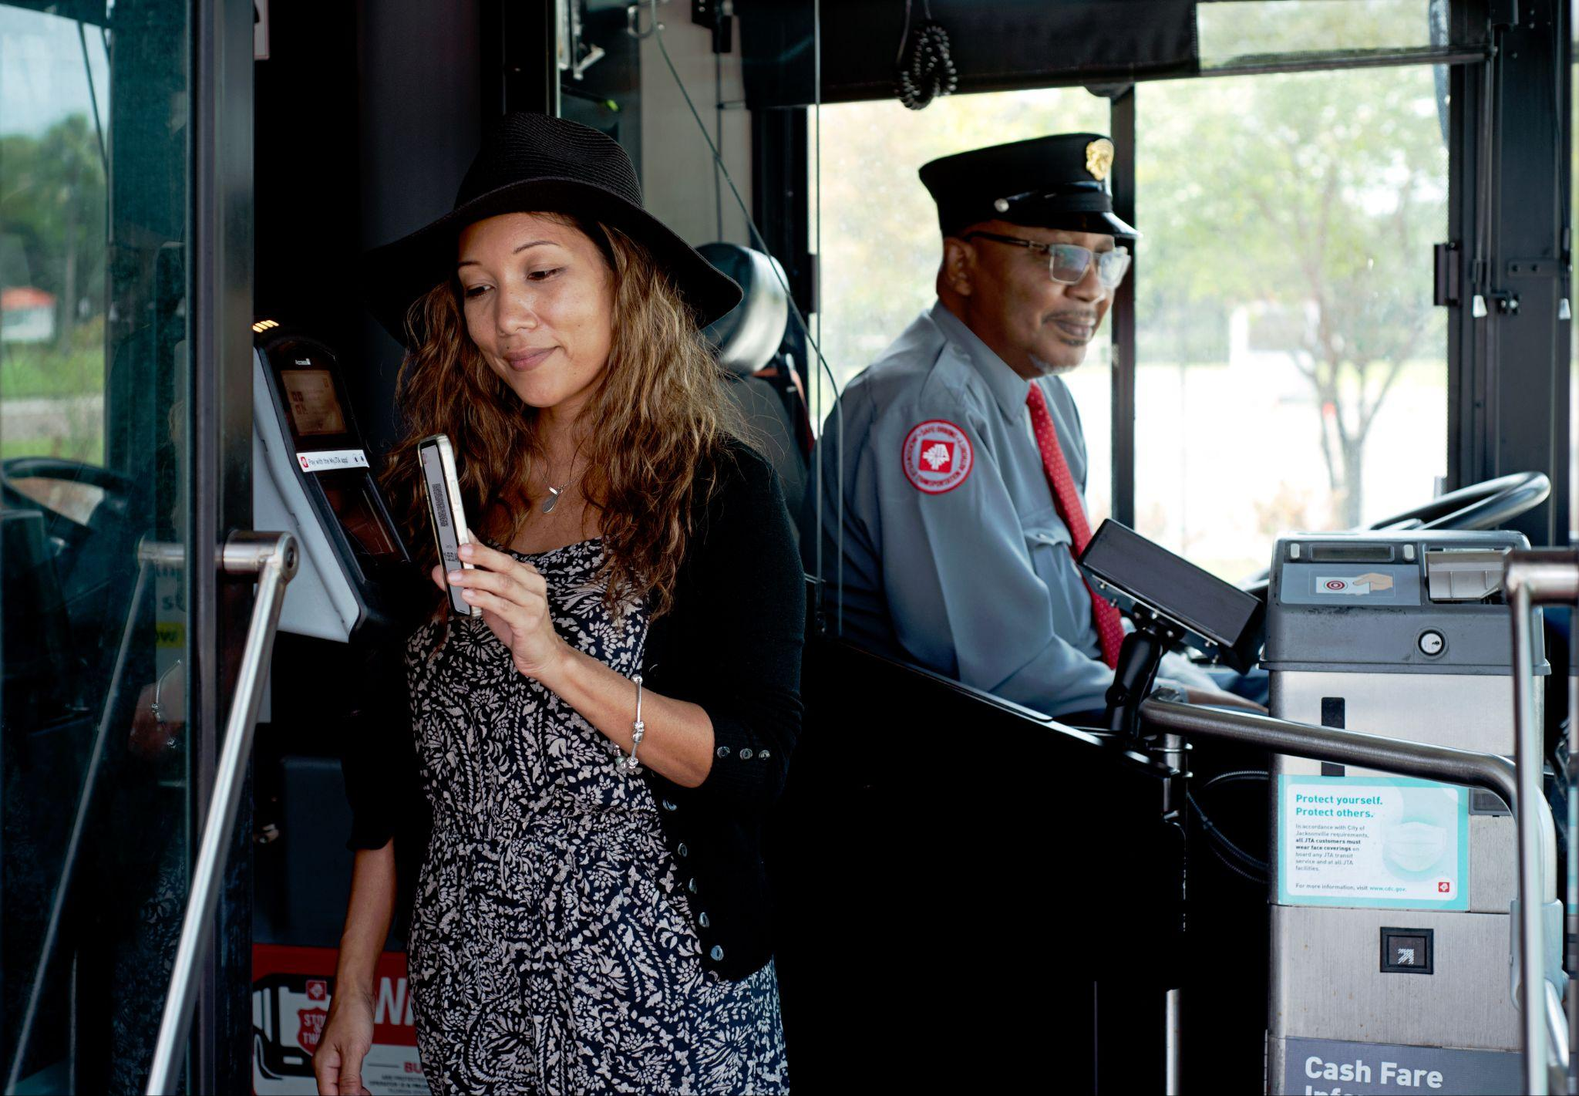
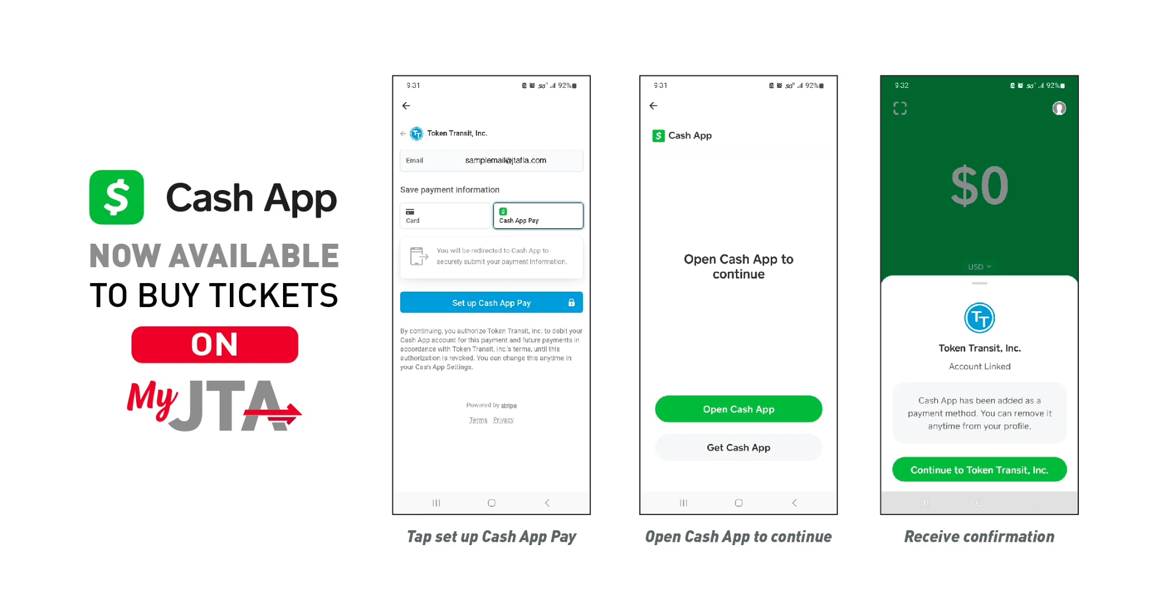

Proposed “Best Fare” modification
JTA proposes a "Best Fare" modification based on fare capping, which would reward passengers with free rides after they meet the fare equivalent of a daily, weekly or monthly pass.
Customer Benefits
Improves customer experience
Simplifies the fare discount for riders
Improves fare
equity
Riders pay the same fare on all passes
Notes:
The original MyJTA app discount in 2019 was a marketing promotion used to encourage the use of the MYJTA app.
At the time, app usage was less that 18%. Since then, App usage has grown more than to around 38%.
Now that more customers are using the App, JTA plans to implement the Best Fare for all.

Slide 3
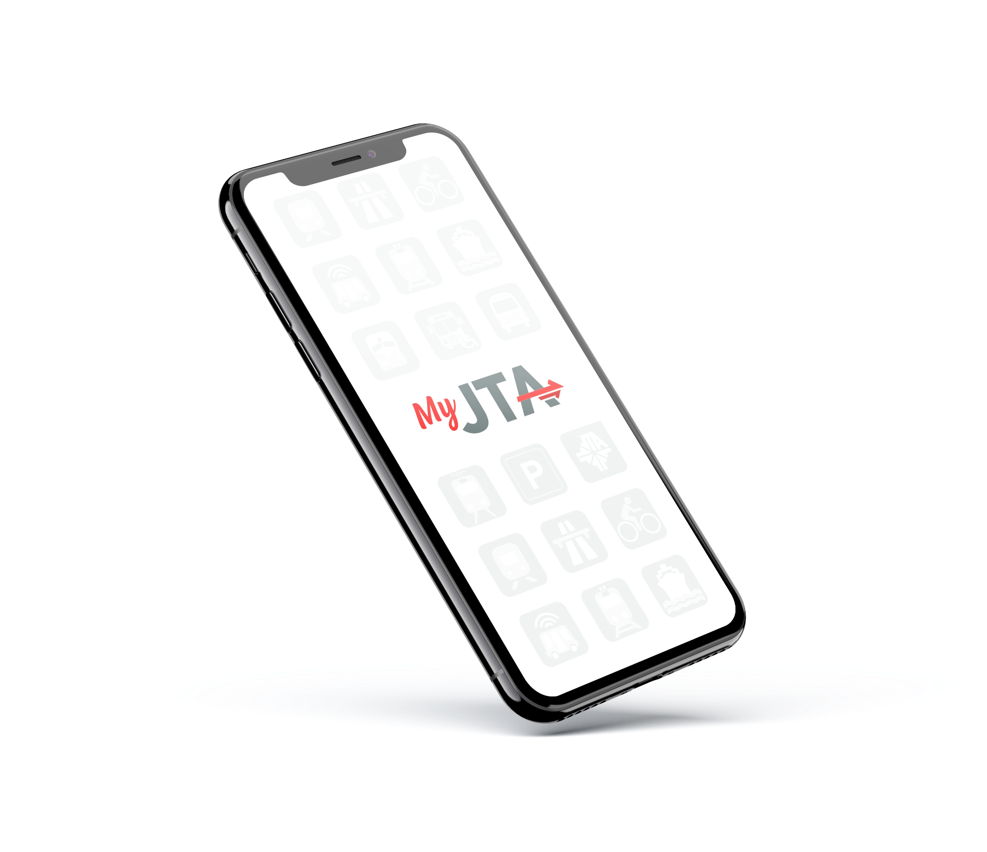
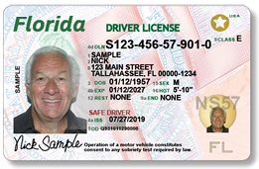
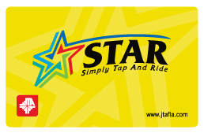
Proposed Fare Policy Update
  Implement “Best Fare”
  The JTA proposes a "Best Fare" modification based on fare capping, which would reward passengers with free rides after they meet the fare equivalent of a daily, weekly or monthly pass.
Now Accepting (Seniors aged 65 and up)
Florida Driver License
Florida state-issued ID card
Seniors Star Card
Notes:
JTA’s proposal is to replace its current MyJTA app promotional discount, and implement a “best fare” discount where riders using the mobile app will always pay the lowest available fare
The fare policy update also will allow seniors to use a Florida driver’s license or state issued Florida ID card, as well as the current senior STAR Card to ride for free.

Slide 4
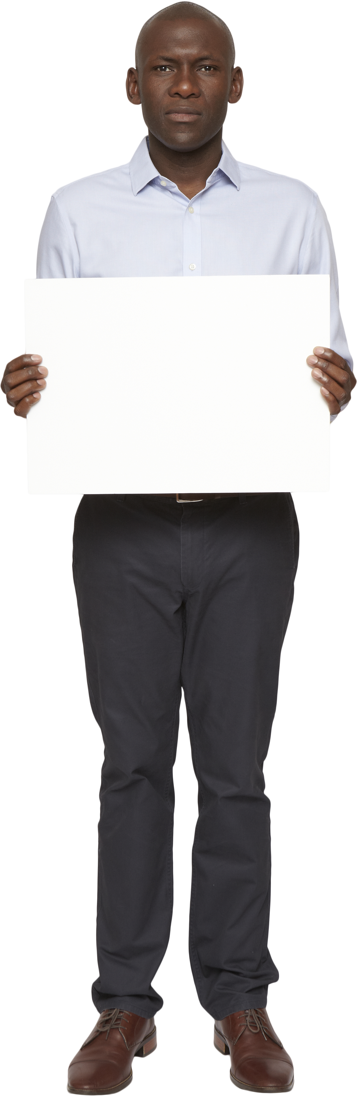
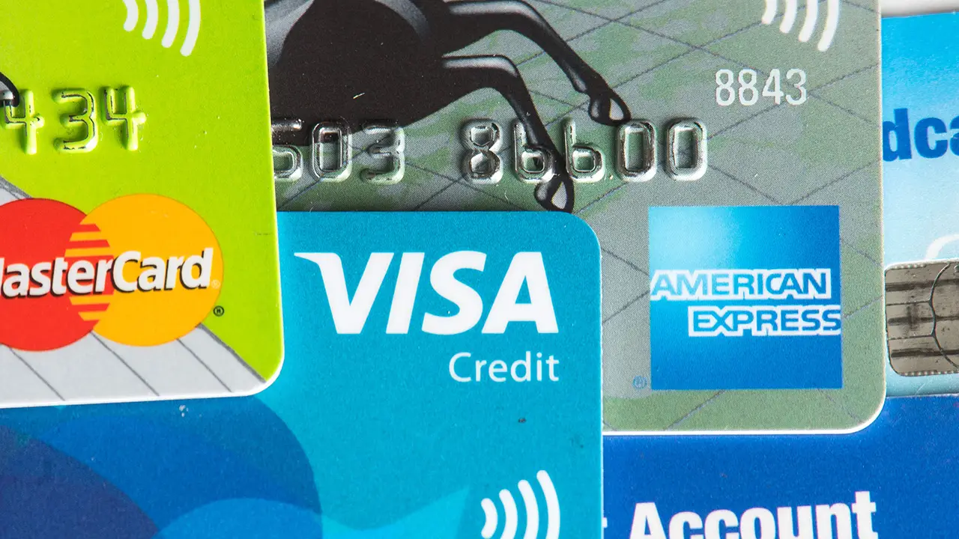
How Does “Best Fare” Work
1-ride
1-day
SAVINGS
$1.75
$4.50
$1.75
TOTAL COST:
$4.50
TOTAL SAVINGS:
$.75
MyJTA
saves me money
$1.75
TOTAL COST:
$5.25
BEST
FARE
*Passes activated within 1-day period
Notes:
Here’s how it works.
The most common fixed route bus passes purchased by JTA customers are single rides or 1-day passes.
If you buy three of the one-ride passes in the app, that equals $5.25.
However, the one-day unlimited ride passes is only $4.50.
So, the MyJTA app will automatically cap your payment for you at the lower $4.50 – saving you 75 cents. Giving you, the rider, the Best Fare.
Here’s another example. If you activate 3, one-day passes within a 3-day period, the total would be $13.50. But a three-day pass is only $12. So the MyJTA app will cap that purchase at the $12 limit, saving you $1.50, giving you the Best Fare.

Slide 5

How Does “Best Fare” Work
1-day
3-day
SAVINGS
$4.50
$12.00
$4.50
TOTAL COST:
$12.00
TOTAL SAVINGS:
$1.50
MyJTA
gets me the
BEST FARE
$4.50
TOTAL COST:
$13.50
RIDE MORE
SAVE MORE
*Passes activated within 3-day period
Notes:
Here’s how it works.
The most common fixed route bus passes purchased by JTA customers are single rides or 1-day passes.
If you buy three of the one-ride passes in the app, that equals $5.25.
However, the one-day unlimited ride passes is only $4.50.
So, the MyJTA app will automatically cap your payment for you at the lower $4.50 – saving you 75 cents. Giving you, the rider, the Best Fare.
Here’s another example. If you activate 3, one-day passes within a 3-day period, the total would be $13.50. But a three-day pass is only $12. So the MyJTA app will cap that purchase at the $12 limit, saving you $1.50, giving you the Best Fare.

Slide 6
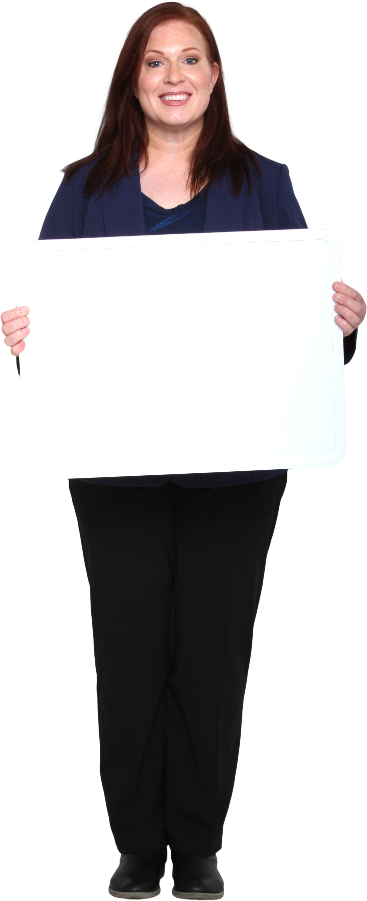
How Does “Best Fare” Work
3-day
7-day
SAVINGS
$12.00
$20.00
$12.00
TOTAL COST:
$20.00
TOTAL SAVINGS:
$4.00
MyJTA app
gets me the
BEST FARE
TOTAL COST:
$24.00
RIDE MORE
SAVE MORE
*Passes activated within 7-day period
Notes:
Here’s an example comparing two, 3-day passes versus a 7-day pass.
Two, 3-day passes will cost you $24. While a single 7-day pass is only $20.
When you activate your 3-day passes on he MyJTA mobile app within a 7-day period, the app will automatically cap your payment at the 7-day best fare rate of $20 – saving you $4 and you can ride unlimited throughout the entire 7 days.
The app automatically gives you the Best Fare.

Slide 7

How Does “Best Fare” Work
7-day
31-day
SAVINGS
MyJTA app
gets me the lowest fare
$20.00
$65.00
$20.00
TOTAL COST:
$65.00
TOTAL SAVINGS:
$15.00
$20.00
$20.00
TOTAL COST:
$80.00
MyJTA app caps your fare at $65
*Passes activated within 31-day period
Notes:
You can save even more on monthly passes.
Many daily riders currently purchase weekly passes. Four weekly’s would cost you $80. However, buying a single 31-day pass on the MyJTA mobile app costs just $65.
The app automatically caps your fare when you reach the $65 limit, saving you $15.
Just by using the free MyJTA mobile app, you automatically get the BEST FARE every time.

Slide 8
Benefits of “Best Fare”
Over 500 current MyJTA app users could see immediate savings
Using the MyJTA mobile app, riders never pay over $65 over
a 31-day period
Simplifies access to discounts
MyJTA users: Ride More, Save More.
February 2024 Mobile App Data
Notes:
Here’s a look at the benefits of the Proposed Best Fare plan.
Over 500 current MyJTA app users could see immediate savings based on their ridership patterns
Riders using the MyJTA app will never pay over $65 over a 31-day period no matter what ticket combinations you purchase
Simply put” If you Ride More, you Save More

Slide 9
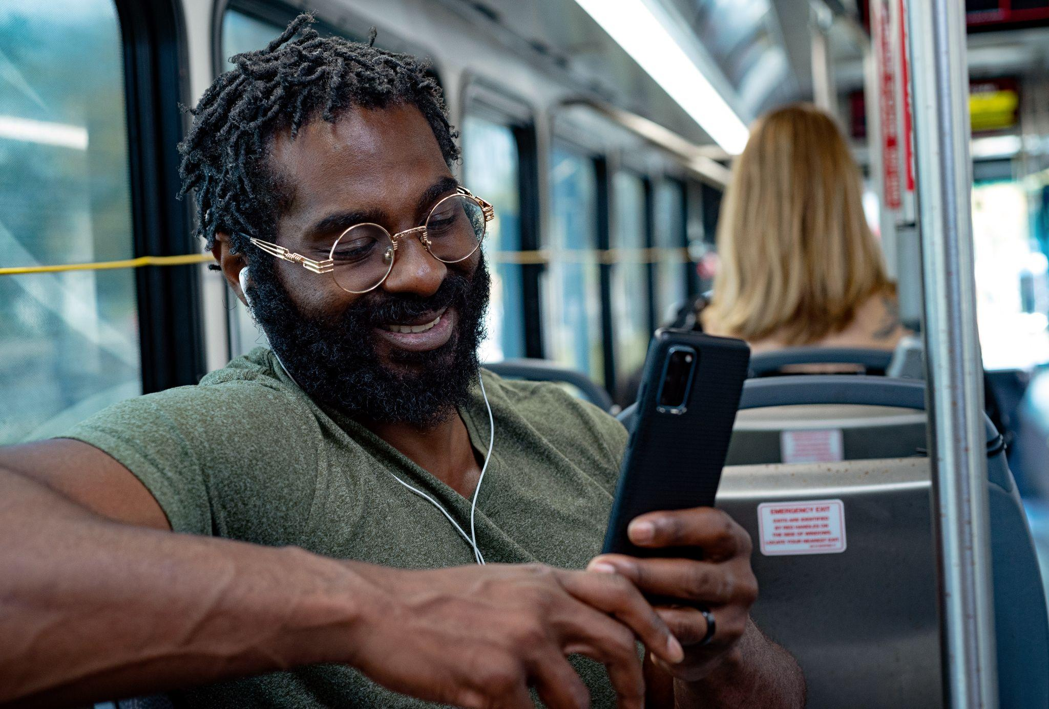
FTA Requirement
Process:
JTA conducted a Title VI analysis as required by the Federal Transit Administration
Seek input from community
Hold public meetings and official hearing
JTA Board of Directors to review proposal
Notes:
A Title 6 analysis is required by the Federal Transit Administration. That analysis has been completed and no adverse impacts were identified.
JTA wants to hear your feedback on this policy change and is currently holding public meetings and an official hearing, findings of which will be reviewed by the JTA Board of Directors before any final decision is made.

Slide 10
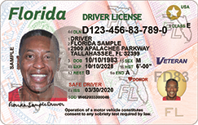
Simplifying Access to Free Rides for Seniors
Florida Driver’s License and State of Florida ID accepted as proof of eligibility
for riders ages 65 and older to access fixed route services
The senior STAR card will continue to be accepted
Customer Benefits
Improve equity
in fares
Increase proportion of Seniors able to access free rides
Improve customer experience
Improving access and removing barriers. Simpler for Seniors
Notes:
Another key element of the policy change is expanding the options for seniors to ride. Currently, seniors much show their senior STAR card to verify their eligibility to ride free on JTA. This new proposal will allow seniors to scan their Florida Driver’s License or state-issued ID card, or continue to use the STAR card.
If approved, seniors can immediately board a fixed-route bus from anywhere on the system with just their ID or DL. The system will not accept out-of-state DL or ID cards.

Slide 11
Public Outreach Timeline
Community Engagement Schedule
The timeline below shows the different steps in the proposed fare policy modification process:
              Tuesday, March 5, 2024: Comment period opens
          Thursday, April 4, 2024: Comment period closes
          April 2024: Comments reviewed and evaluated
          Thursday, April 25, 2024: Board meeting
          Wednesday, May 1, 2024: New policy takes effect (if approved)
Notes:
Here are the key timeline markers for JTA to receive and review your comments, and the proposed date when they would take effect if approved by the JTA Board of Directors.

Slide 12
Public Meeting Schedule
Tuesday, March 5, 2024 (9-11 a.m.)
Wednesday, March 6, 2024 (11 a.m. – 1 p.m.)
Thursday, March 7, 2024 (5-7 p.m.)
Thursday, March 14, 2024 (5-7 p.m.)
Thursday, March 21, 2024 (11 a.m. – 1 p.m. and 5-7 p.m.)
All meetings will be held at the 2nd floor reception at
Jacksonville Regional Transportation Center at LaVilla
100 LaVilla Center Drive
Jacksonville, FL 32204
Notes:
Public meetings to discuss the proposed fare policy changes will be held in the 2nd floor reception of the JRTC.. The schedule with dates/times is shown on your screen.

Slide 13
Public Hearing Schedule
Thursday, April 4, 2024 (11 a.m.-1 p.m. and 5-7 p.m.)
Presentations will be held at the following times:
11:15 a.m.
12:15 p.m.
5:15 p.m.
6:15 p.m.
The hearing will be held in the 3rd floor Boardroom at
Jacksonville Regional Transportation Center at LaVilla
100 LaVilla Center Drive
Jacksonville, FL 32204
Notes:
There will be four formal hearing sessions on Thursday, April 4th to finalize comments and feedback on the proposed fare policy changes. The schedule with location and presentation times is shown on your screen.

Slide 14
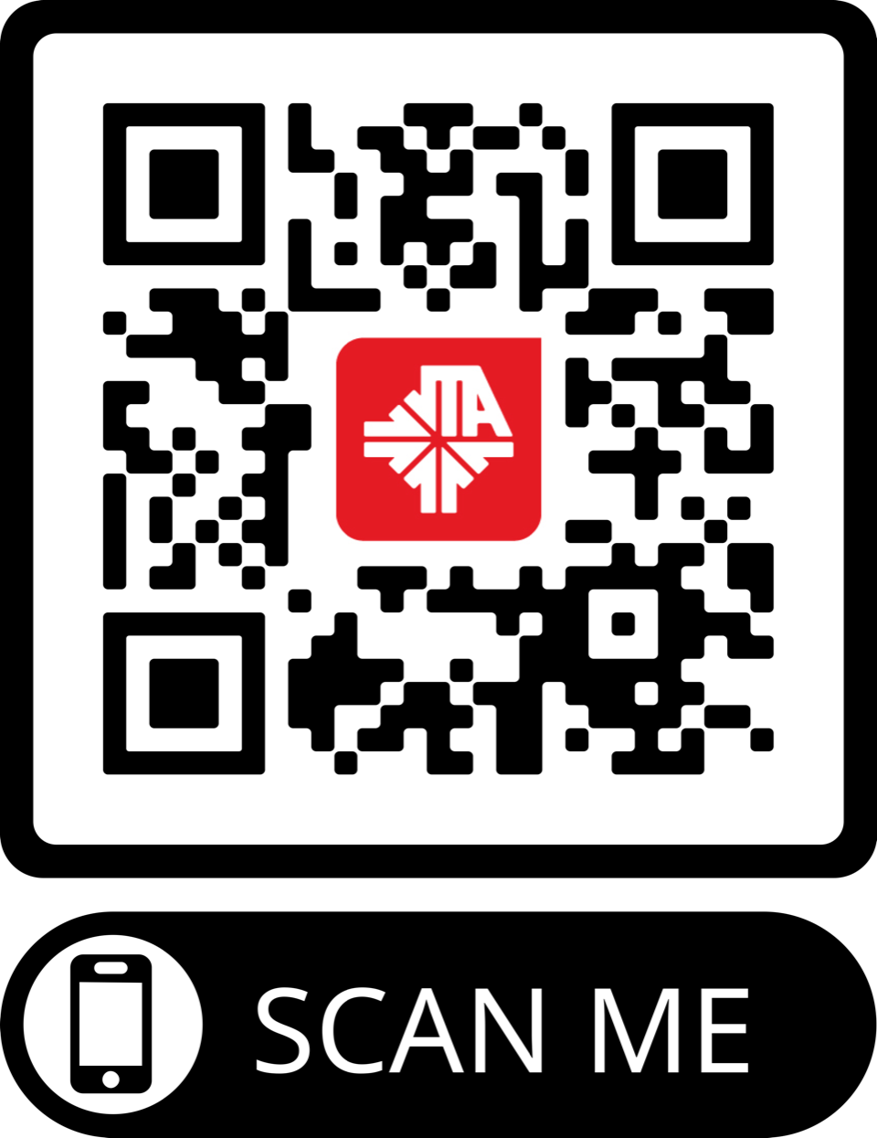
Online Comments/Feedback
On this site: https://publicinput.com/proposedfarepolicymodification
Please submit your written comments using the survey link or the QR code
You can also provide verbal comments by calling 1-855-925-2801 and entering code 1210 to leave a voicemail with your comments.
Notes:
You may also give your comments virtually, or over the phone. To submit an online comment, follow the link on your screen. To leave a comment over the phone, please call the number on the screen and enter the code to leave a voicemail.

Slide 15
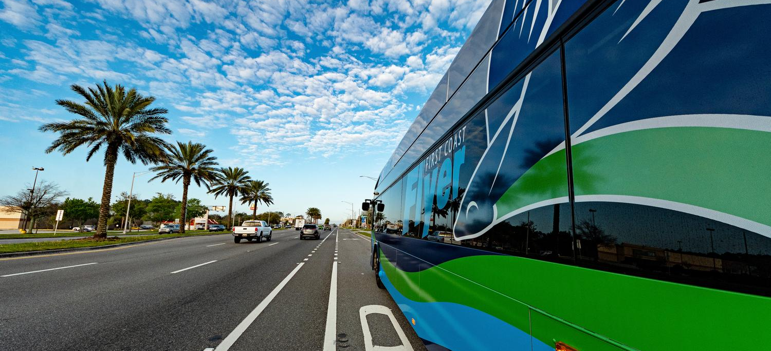
Thank You
Notes:
Thank you for attending today public event on the proposed fare policy changes. We appreciate your time, attention and interest in helping make the bus service in Jacksonville the best in can be, for you, our customers. This proposed change will provide all MyJTA app user users with the Best Fare.
This presentation will start again in one minute

Slide 16
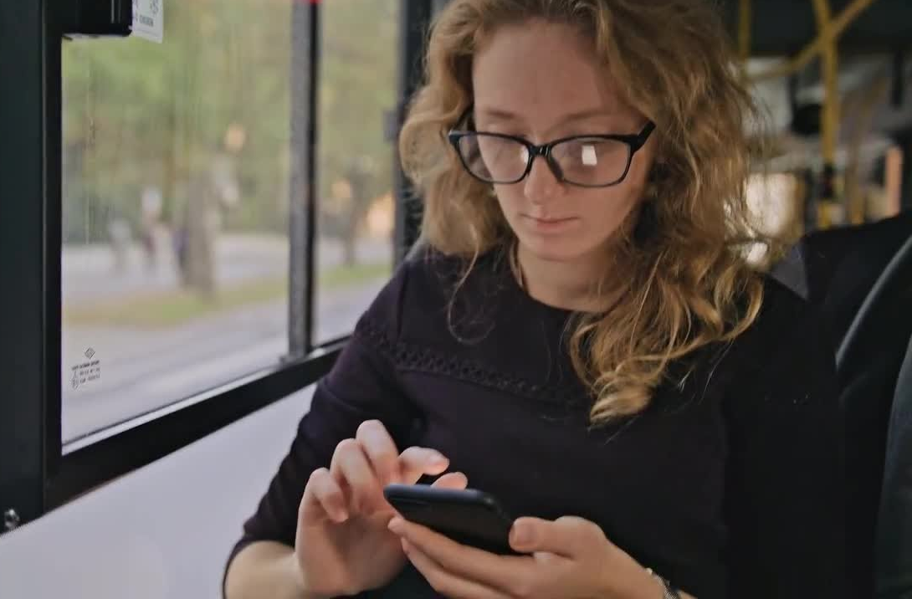
How Does “Best Fare” Work - Example
Customer purchases 3, one ride-tickets at $1.75 each via the MYJTA app
The customer purchases for the day total $5.25
The 1-day pass cost $4.50
Customer then receives a notification text upon activation of the third pass
A refund is issued back to the customer credit card or cash app account for $.75
The customer now has the ‘Best Fare”. The price is capped at $4.50
With “Best Fare” the customer has unlimited trips for the duration of the day.
Notes:
Here’s how it works.
The most common fixed route bus passes purchased by JTA customers are single rides or 1-day passes.
If you buy three of the one-ride passes in the app, that equals $5.25.
However, the one-day unlimited ride passes is only $4.50.
So, the MyJTA app will automatically cap your payment for you at the lower $4.50 – saving you 75 cents. Giving you, the rider, the Best Fare.
Here’s another example. If you activate 3, one-day passes within a 3-day period, the total would be $13.50. But a three-day pass is only $12. So the MyJTA app will cap that purchase at the $12 limit, saving you $1.50, giving you the Best Fare.

Slide 17
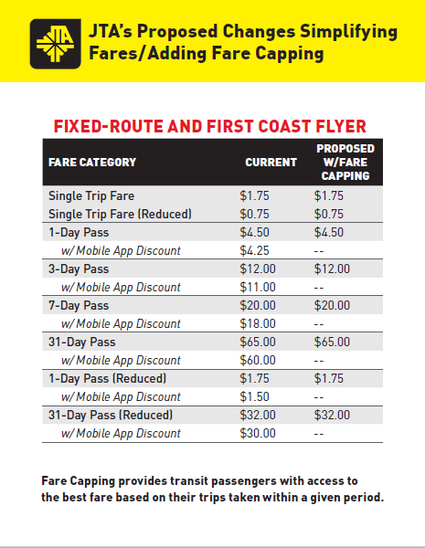
Fare Capping Continued
Use of MyJTA technology to improve Rider Experience
Customer Benefit
Improved fare equity
Improve customer experience
Notes:
Here are some key factors of the proposed policy change. First of all, NO FARES ARE BEING INCREASED with this proposal.
Riders will not have to change their buying behaviors, although JTA does encourage customers to use the MyJTA mobile app whenever possible for its overall convenience.
In addition, this new fare policy will ensure that riders always receive the lowest fare possible.

Slide 18
How Does “Best Fare” Work
Fare capping, automatically rewards passengers with FREE rides after they meet the fare equivalent of a daily, weekly or monthly pass.
Buy 3 single ride tickets – 3rd ticket now only $1.00 and ride the rest of the day for free
Buy 3 one-day passes – 3rd ticket now only $3.00 and ride the rest the day for free
Buy 2 three-day passes – 2nd ticket now only $8.00 and ride the rest of the week for free
Buy weekly passes – 4th ticket now only $5.00 and ride the rest of the month for free
* Purchase MUST be made on the MyJTA mobile app to receive the discount
Notes:
8008 accounts all validations (all services_
6787 – purchased at one – Adults Fixed Route Account pass
3631 – Single Trip at least one single trip that is 53%
3299 – Purchase at least one 1-day 48%
Customer are buying a Combination
Number of 1-days activated over 15 1-day in a month 584
Number single riders activated over 38 – only 31 accounts
Number of 3-day pass riders that would qualify for a monthly pass 399 with over 6 activations in a month
Here’s how it works.
The most common fixed route bus passes purchased by JTA customers are single rides or 1-day passes.
If you buy three of the one-ride passes in the app, that equals $5.25.
However, the one-day unlimited ride passes is only $4.50.
So, the MyJTA app will automatically cap your payment for you at the lower $4.50 – saving you 75 cents. Giving you, the rider, the Best Fare.
Here’s another example. If you activate 3, one-day passes within a 3-day period, the total would be $13.50. But a three-day pass is only $12. So the MyJTA app will cap that purchase at the $12 limit, saving you $1.50, giving you the Best Fare.

